Slide 1



Washington State Open Data Portal
Andrew Mckenna-Foster
Summer 2019
Washington State Library

Slide 2
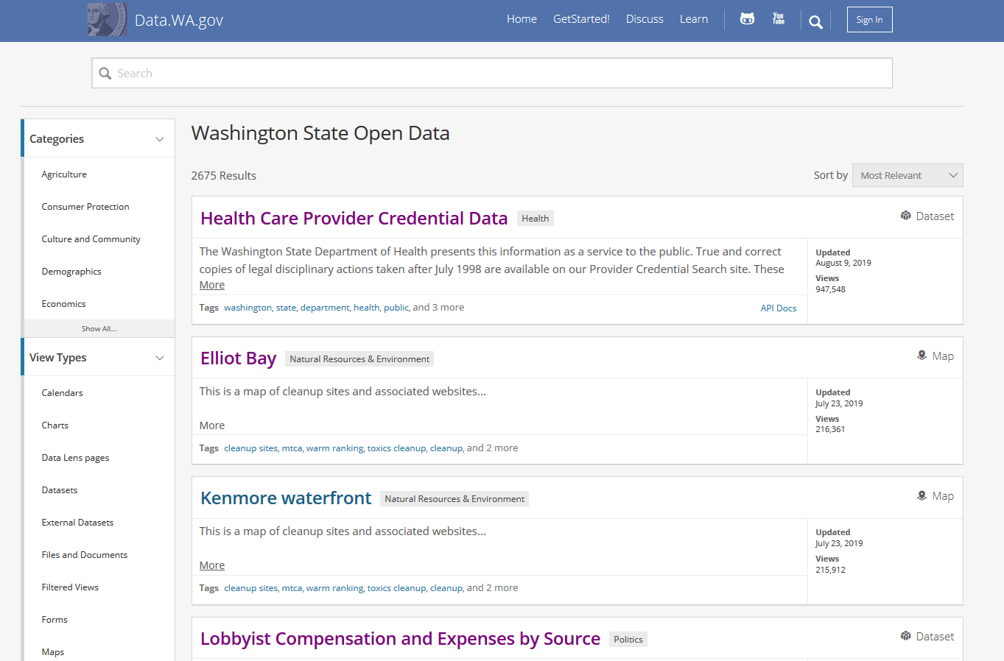
Notes:
Brief overview of portal and next slides are quick looks at the kinds of things available and why an assessment is needed.

Slide 3
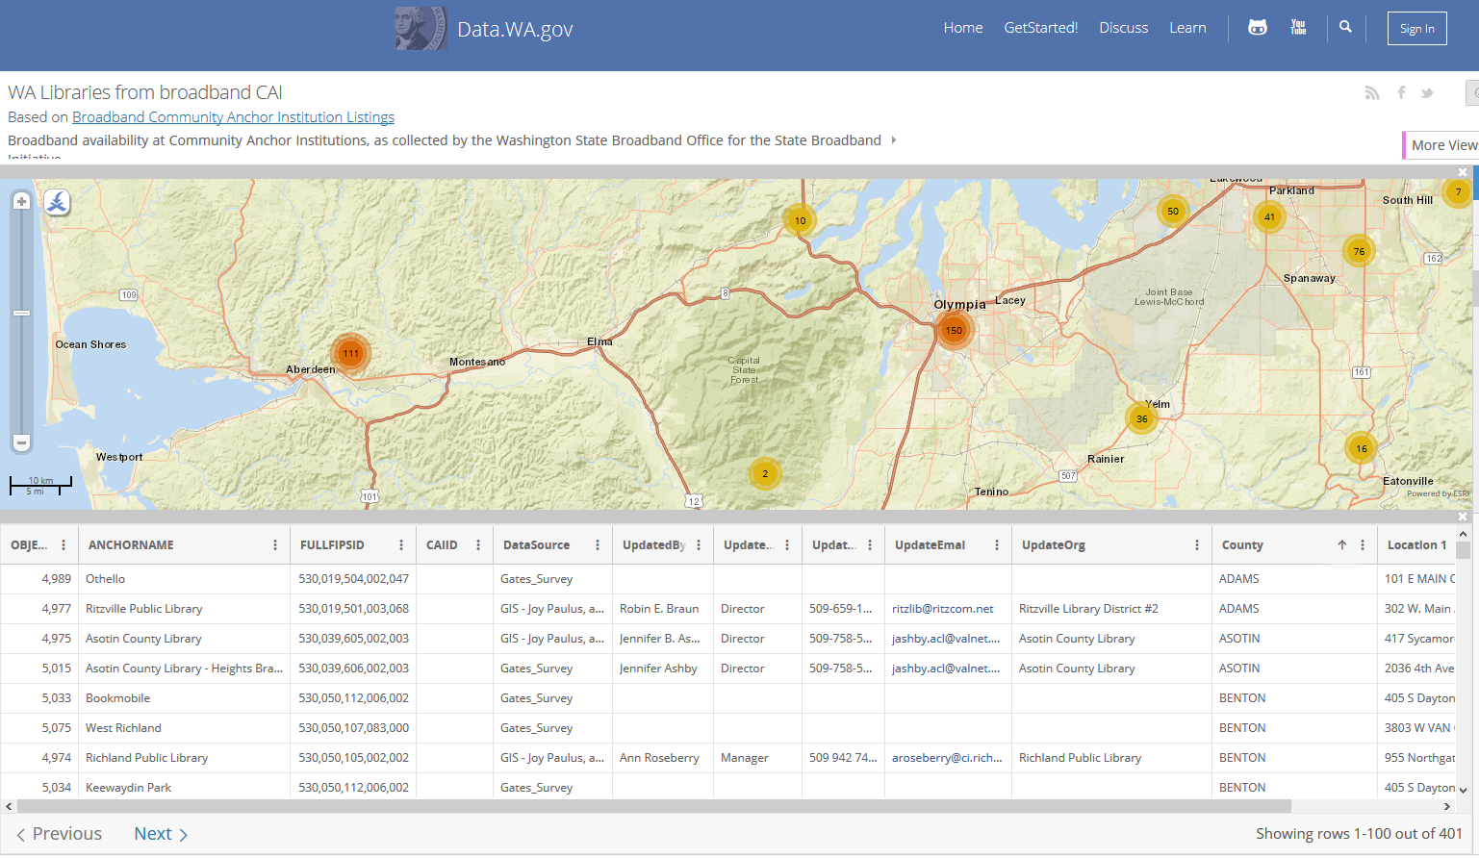
Notes:
There are maps

Slide 4
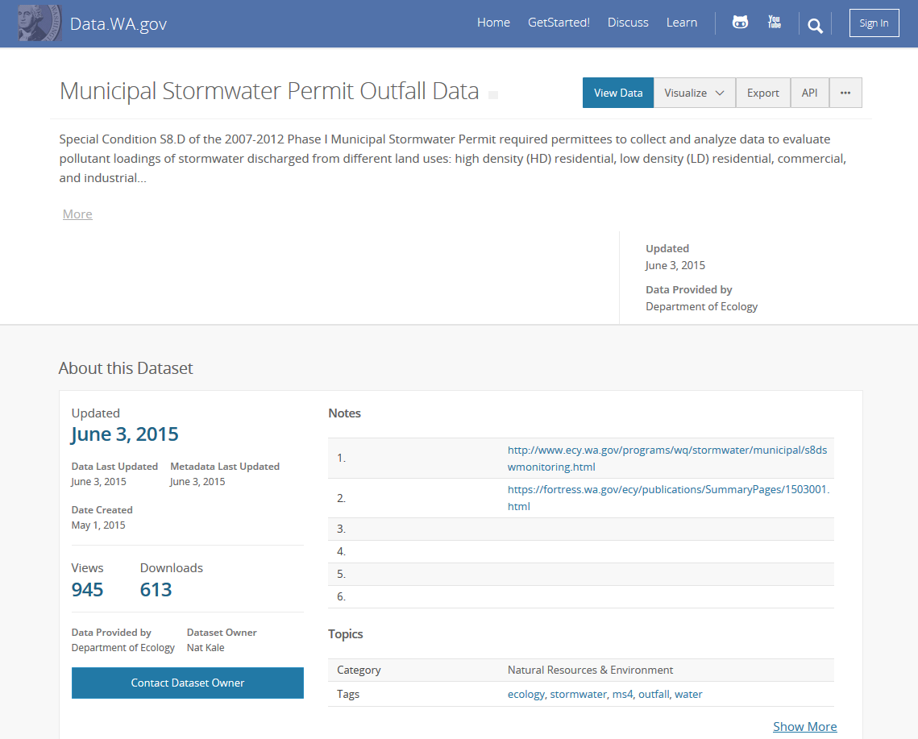
Notes:
Stormwater information

Slide 5
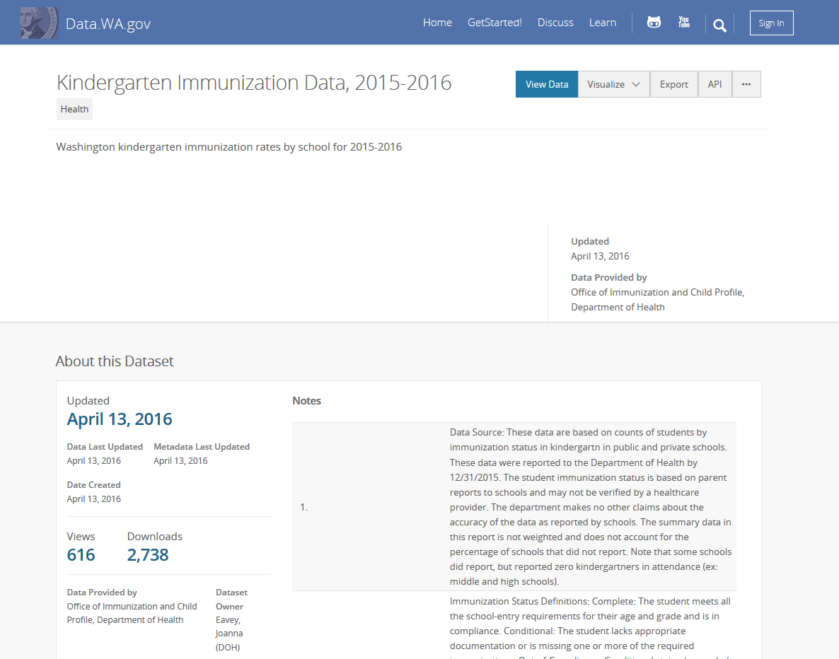
Notes:
Immunization data

Slide 6
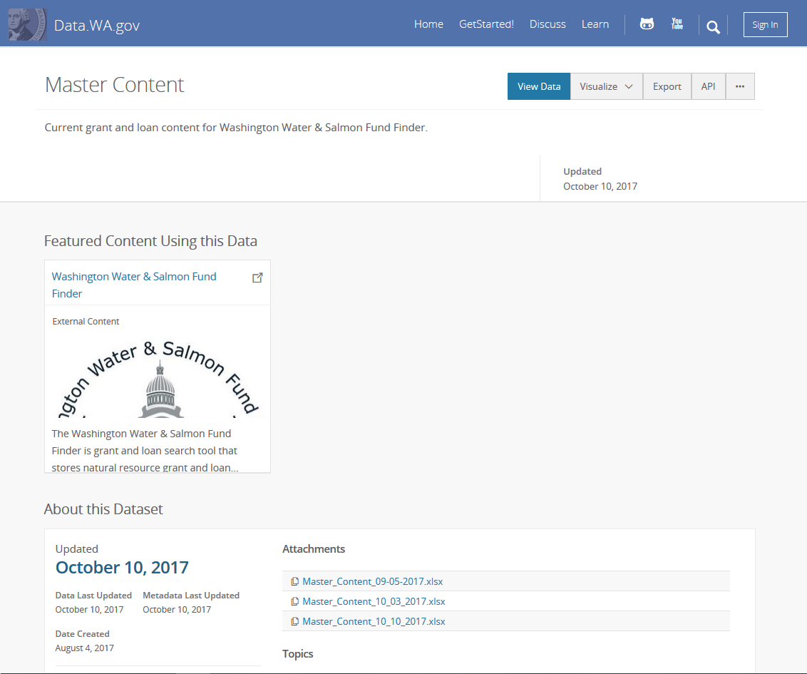
Notes:
Some datasets have great metadata, others have problems.

Slide 7
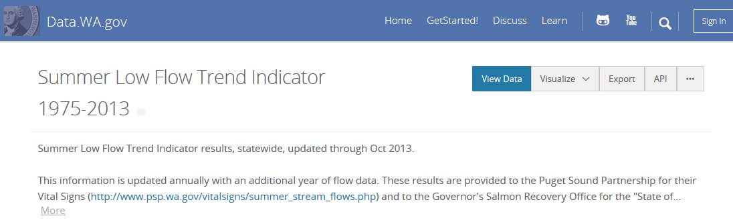
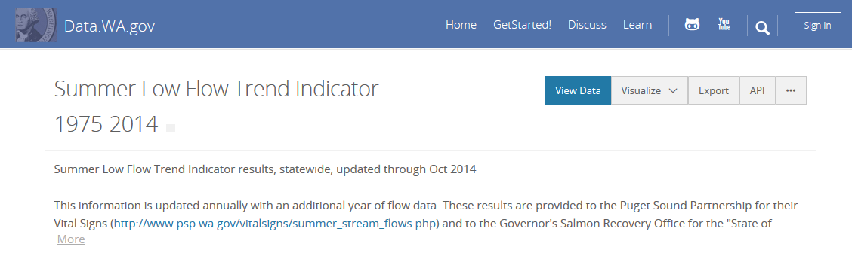
Notes:
13% of sampled seem to be candidates for consolidating multiple datasets into one annually updated dataset.

Slide 8
Dataset Titles
Snake Harvest
Master Content
DEL Office Locations
Snake Final Abundance 01022013
Coast Complete Metrics
Imaged Documents and Reports
WDFW-Adult Returns
Notes:
There are some mystifying titles

Slide 9
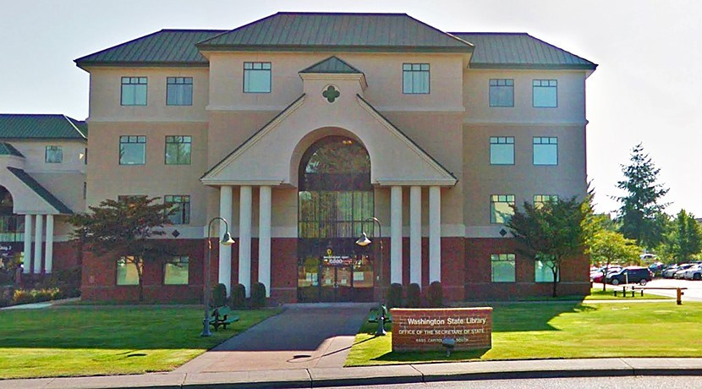
Curatorial Role for the State Library
Interview Agencies Assess metadata/data quality
Notes:
If the State Library takes on a curation role, how should it direct its energy? I used Interviews and metadata assessment to gather information to help Kathleen direct curation efforts.

Slide 10
Agency Interviews
Publishing Behaviors:
User focused
Upload and forget
Internal use
Transparency
Agencies view the portal positively
Users:
Other agencies
NGOs
Local governments
Federal agencies
3rd parties
Citizens
Most plan to continue or increase publishing

Slide 11
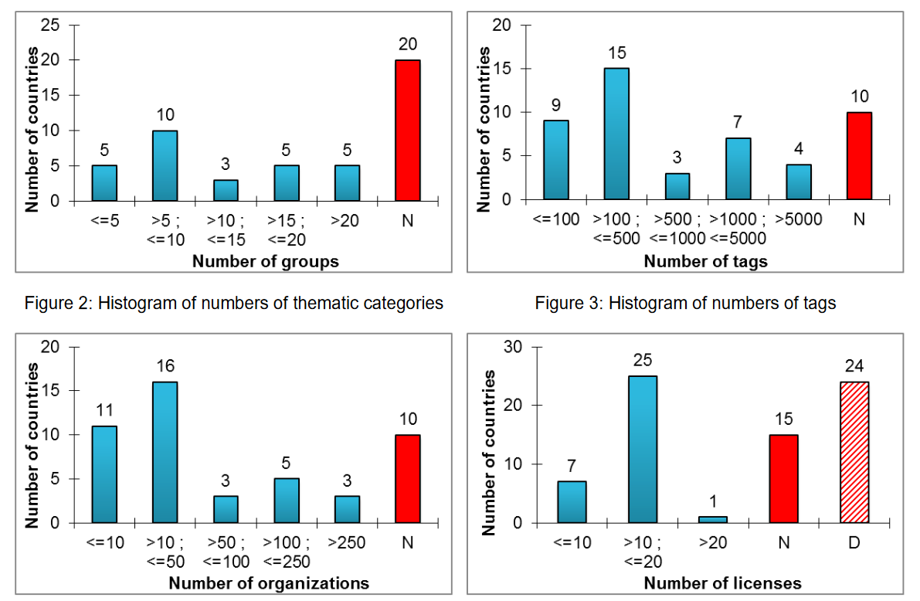
Low Quality Metadata - A Global Issue
“Open data quality – the next shift in open data?”
Open Knowledge Foundation 2017
Machova and Lnenicka 2017
Vetrò et al. 2016
Kubler et al. 2018
Umbrich et al. 2015
Notes:
Umbrich et al. 2015 - Majority datasets are around 60% complete
Vetrò et al. 2016 - ~90% compliance with e-Gov Metadata Standard
Machova and Lnenicka 2017 – Metadata quality averaged 65% +/- 11
Kubler et al. 2018 – Most portals fail to include temporal, spatial, license

Slide 12
Notes:
About half of filled out metadata is hard to understand or incorrect.

Slide 13
Insights and Deliverables
Data.wa.gov cannot be developed and weeded like a traditional library collection
Curation will be a combination of:
Other Deliverables:
Metadata requirements and guidance
Working with publishers
Gradual edits
Selecting datasets for removal
Removal Rubric and Policy
Analysis of “low hanging fruit”
Interview Protocol
Python script for assessment
Notes:
Cannot control selection without completely changing how the portal operates.
Mention core metadata elements, controlled vocabulary, regular assessment.

Slide 14
Questions
Presentation and all supporting material available at:
https://github.com/OpenDataLiteracy/WSL-AMF
Acknowledgments:
Kathleen Sullivan, Will Saunders, Evelyn Lindberg, all the staff at the State Library, the ODL Team, and all the agencies that assisted in gathering information.

